Slide 1
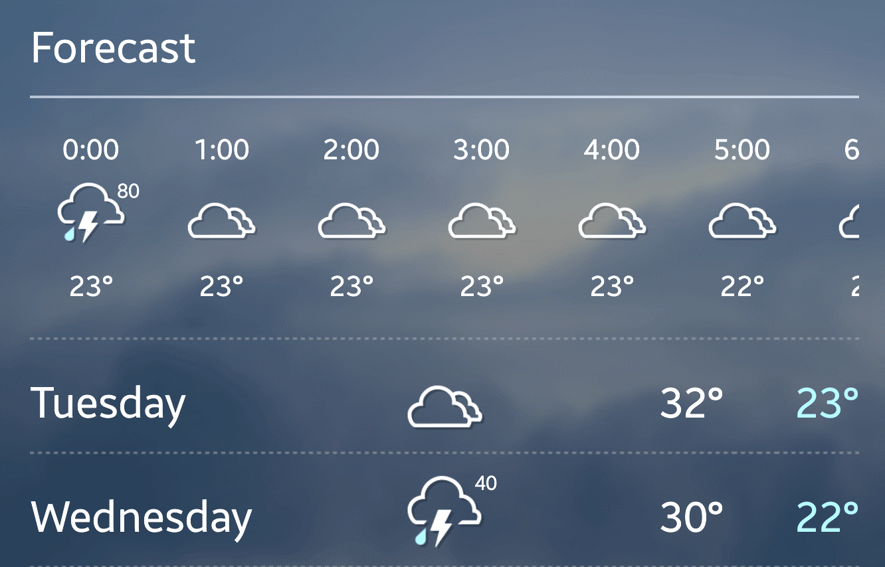
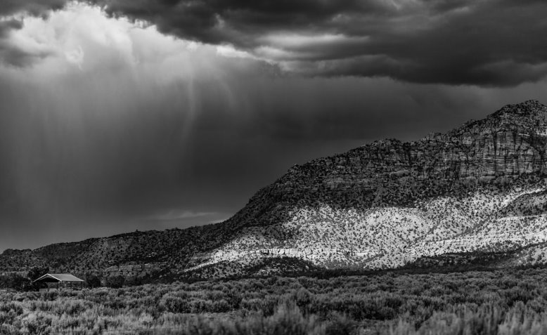
WEATHER FORECASTING USING MACHINE LEARNING (GROUP A)
STEP PRESENTATION BY:
​• CLIFFORD ADDISON​
• MUEEZ UR REHMAN AMJAD ​
• AESHA CHITRAKET SAVANI​
AUGUST 2, 2024

Slide 2
AGENDA
Discussions About Our Entire Project
Progression of Work
Biggest Obstacles
Entire Experience
Success of Group
Insights Gained Throughout the Project
Project Management Experience
Performance of Group
Issues Faced
Understanding of Group Members

Slide 3
introduction
Project Overview
Project Objectives
The Weather Forecasting using Machine Learning project aims to develop accurate weather prediction models utilizing machine learning algorithms. It seeks to leverage historical weather data to create a reliable forecasting system.
The project also aims to train initial models using pre-processed data, evaluate model performance, and deploy the final weather forecasting model for real-time predictions.

Slide 4

Progression of work
Initiation
Planning & Mobilization
Task Allocation
Scheduling
Execution & Testing
Documentation – Ongoing
Definition of Scope

Slide 5
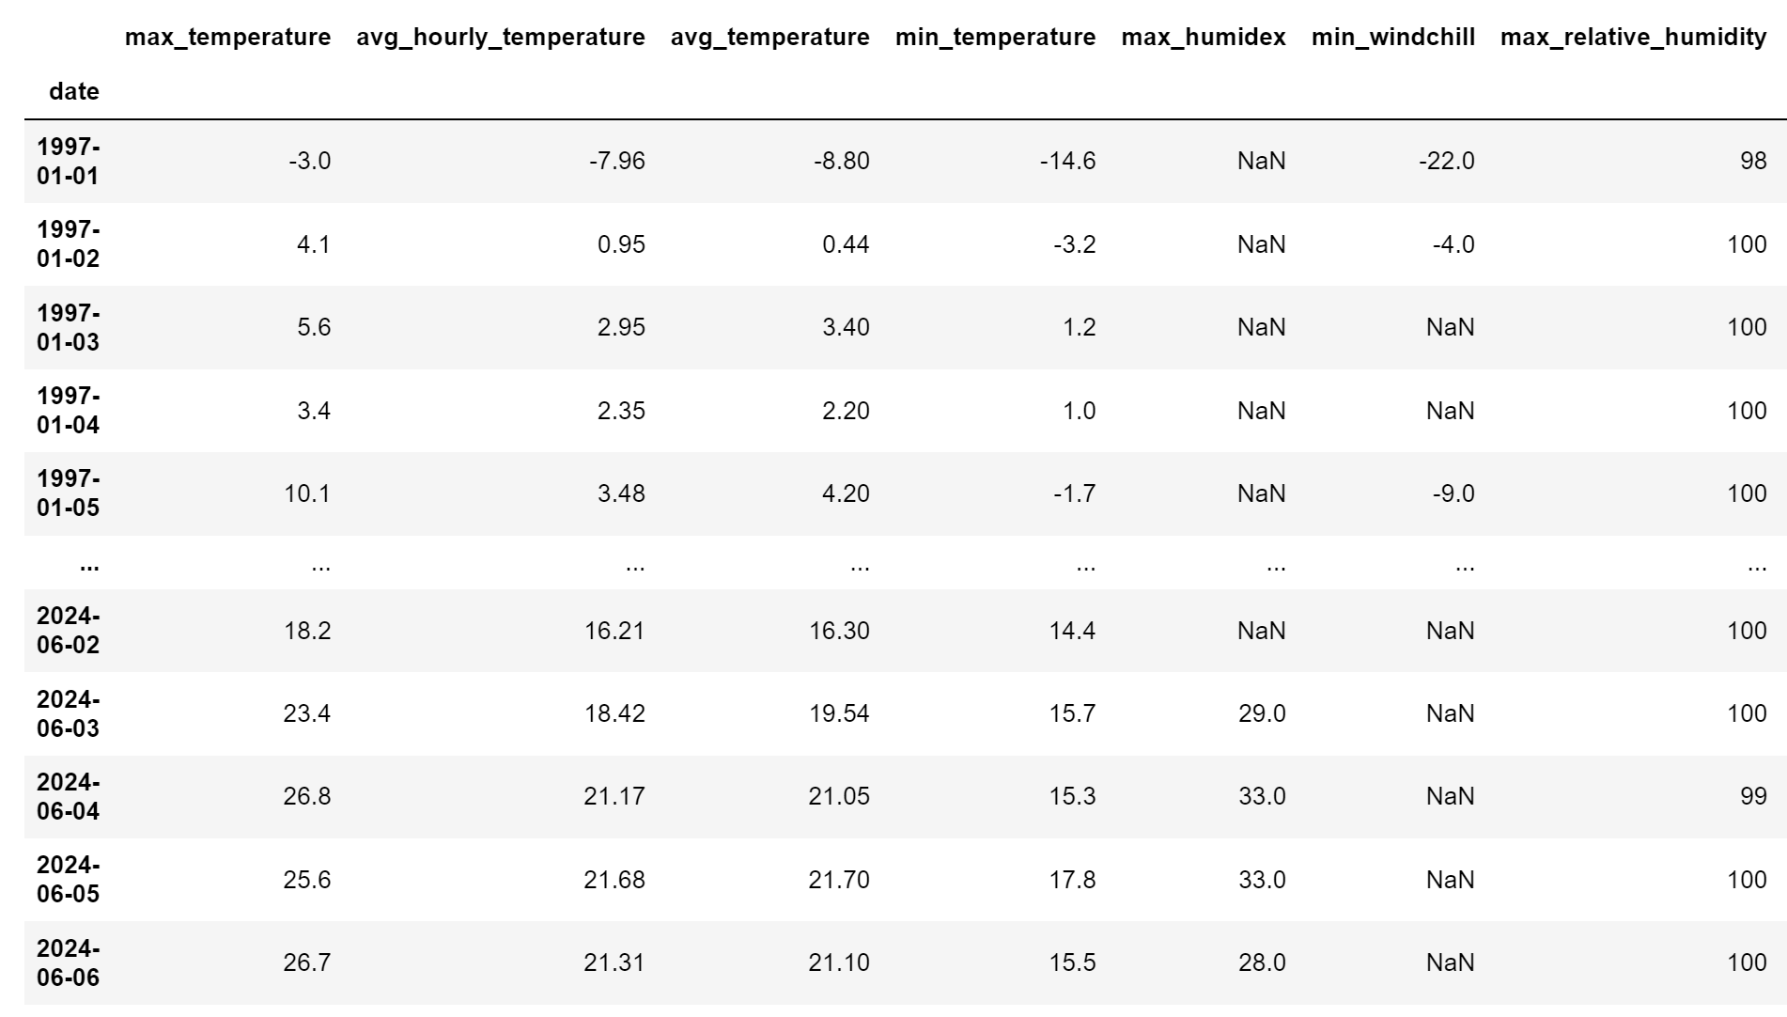
Progression of Work
Collect Historical Weather Data
Visuals of data sample

Slide 6
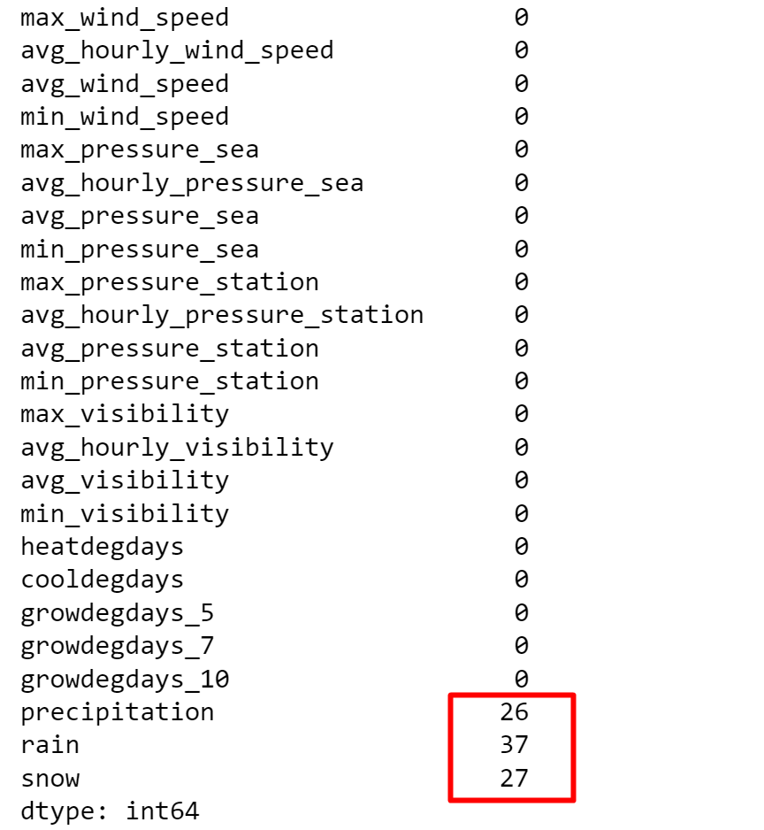
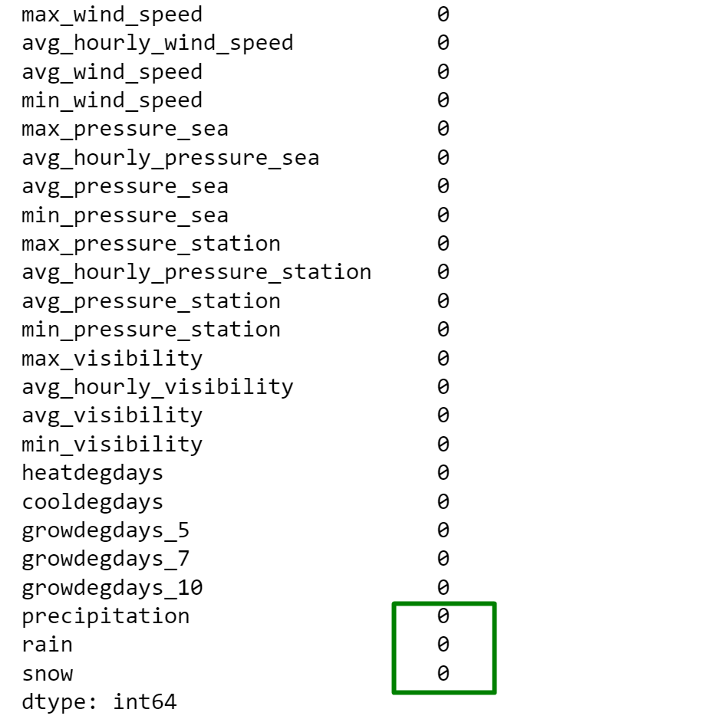
Progression of Work
Data Cleaning and Pre-processing

Slide 7
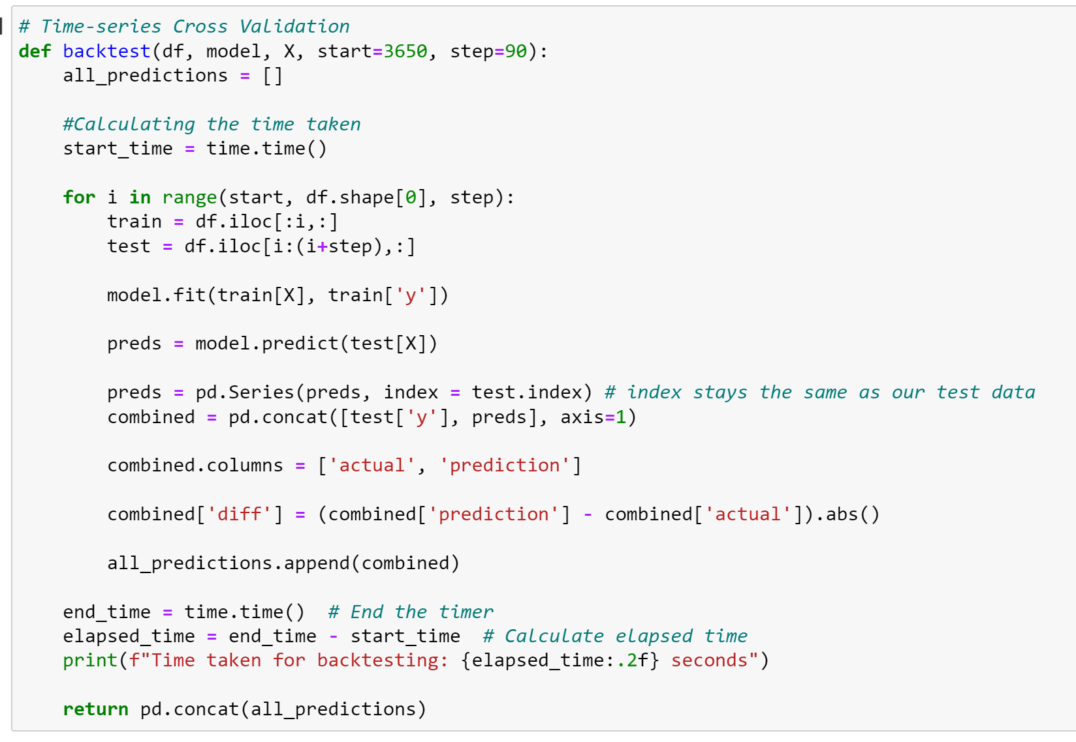
Progression of Work
Model Selection and Implementation
Time Series Cross Validation
Time Series Data

Slide 8
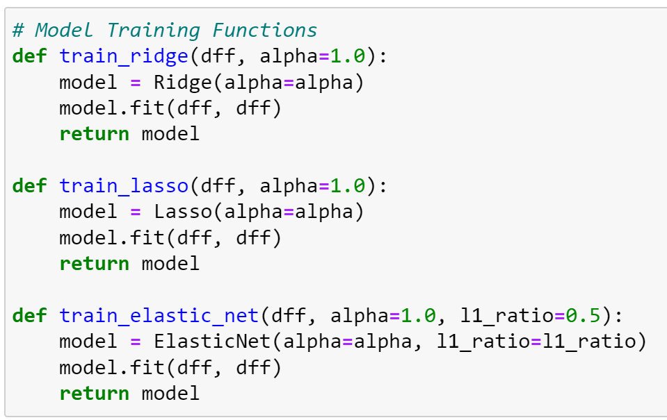
Progression of Work
Training Initial Models
We trained our data with various models including Ridge, Lasso and ElasticNet Regression.

Slide 9
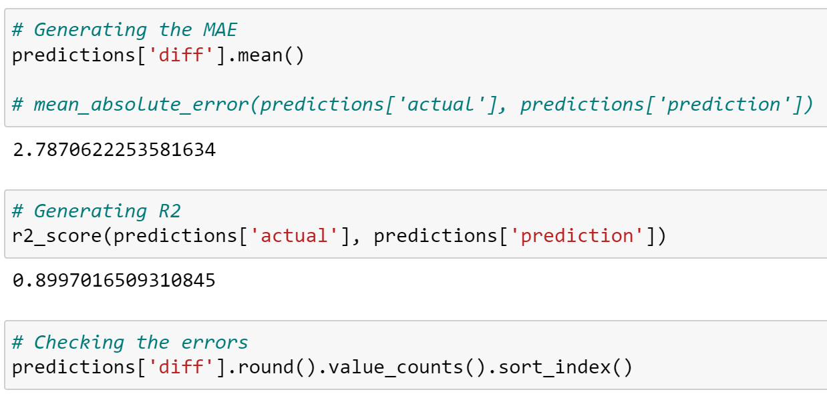

Progression of Work
Model Evaluation
Evaluation metrics used (e.g., $R^{2}$, MAE)
Comparison of initial vs. improved models

Slide 10
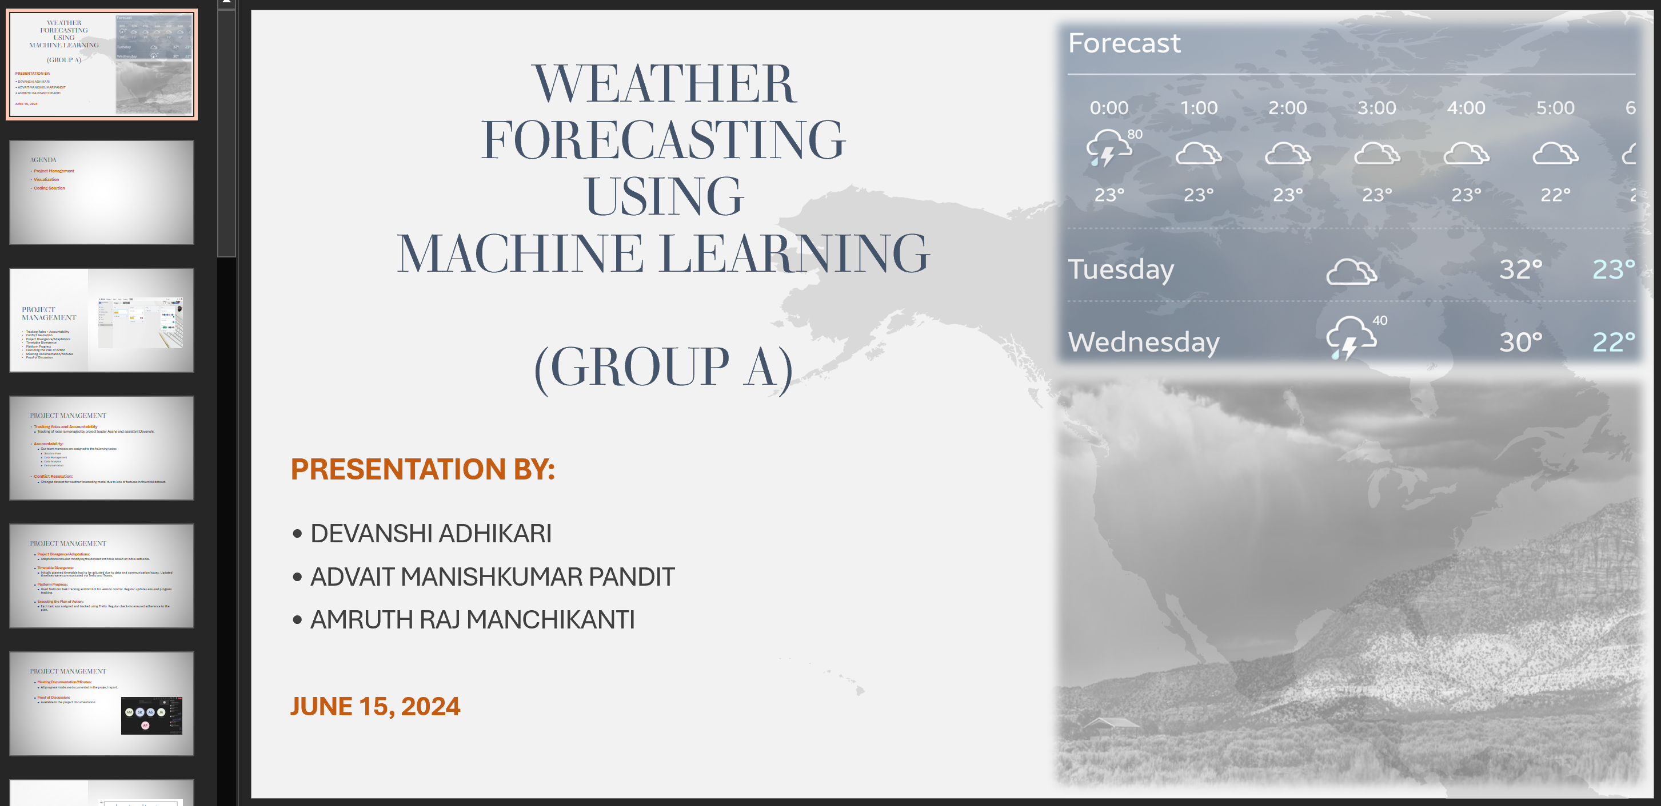
Progression of Work
Preparation for Presentation
Presentations include every discussed item that conforms to the cumulative report of each week’s task
Documentation of the report is done concurrently with the presentation

Slide 11
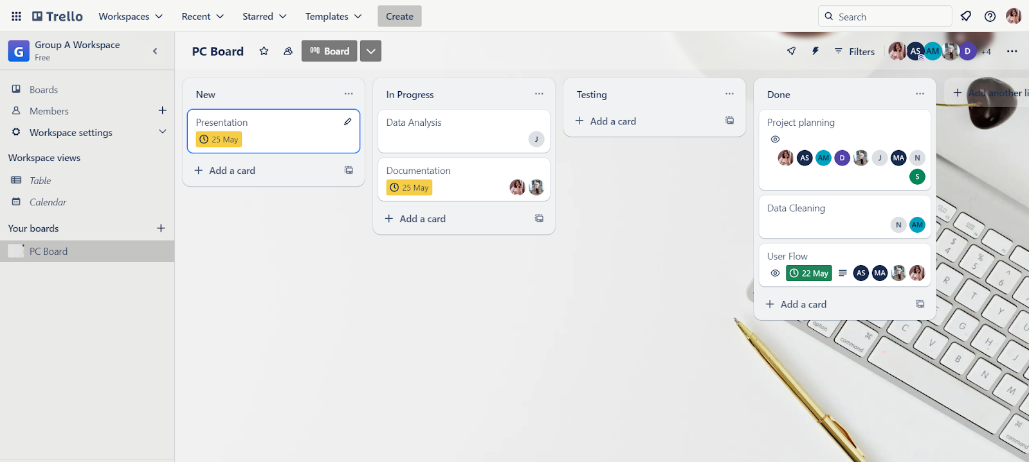
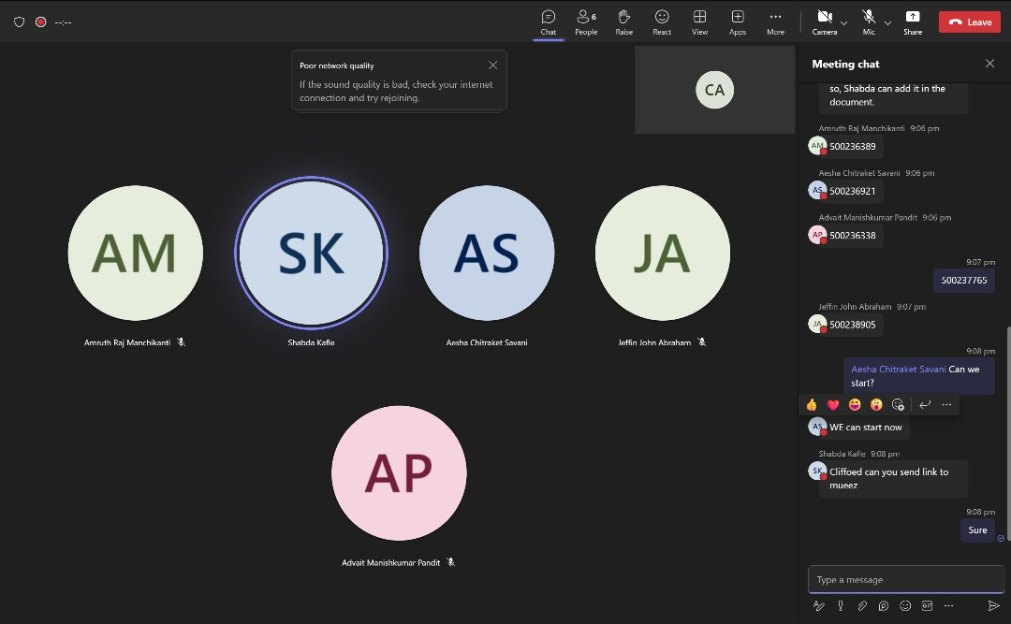
Progression of Work
Meetings and Collaboration
We had in-person and online meetings
Team Communication
Initial issues and solutions (e.g., daily stand-ups)
Tools used (e.g., Trello)

Slide 12
Biggest obstacles
Finding the Right Dataset
The biggest challenge we face was finding the right data that could give us the best of results.
We overcame that but getting the right data with ample features for the purpose of the project.

Slide 13
ENTIRE EXPERIENCE
Development of High-Accuracy Model
We applied different models after EDA and feature engineering to get the best out of our project
Team Effort and Collaboration
All team member had their distinct tasks to perform, and all team members participated in each week’s presentation of our project in class.

Slide 14
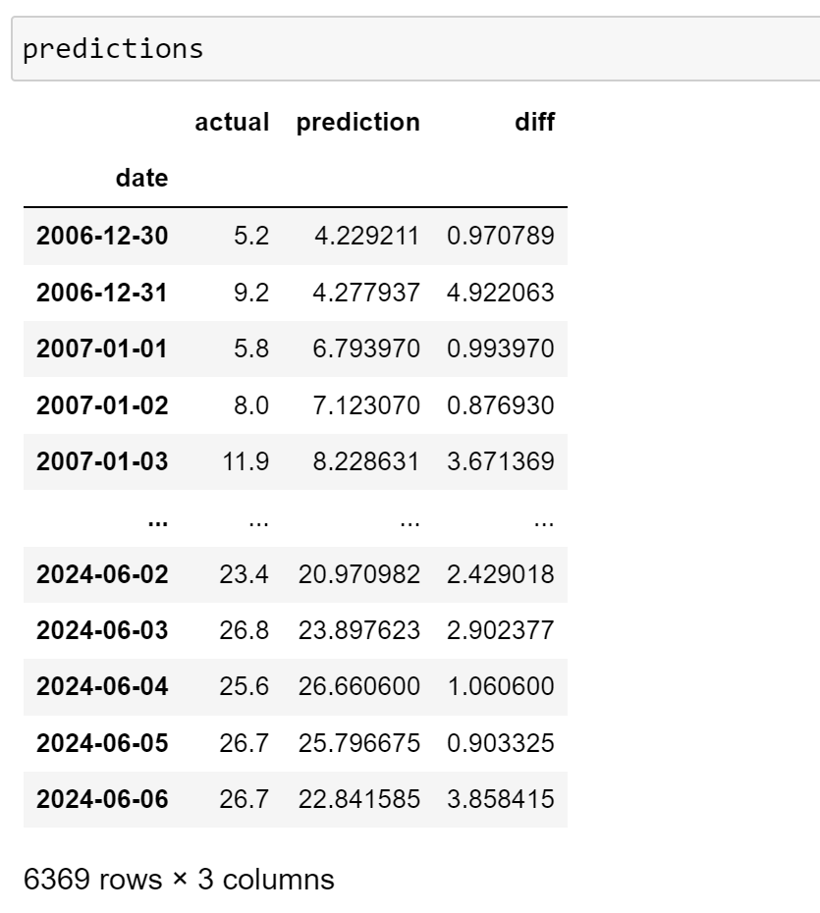
ENTIRE experience
Visuals of Model Predictions vs. Actual Data
We cross-reference our predictions with the actual data to ascertain the performance of our models

Slide 15
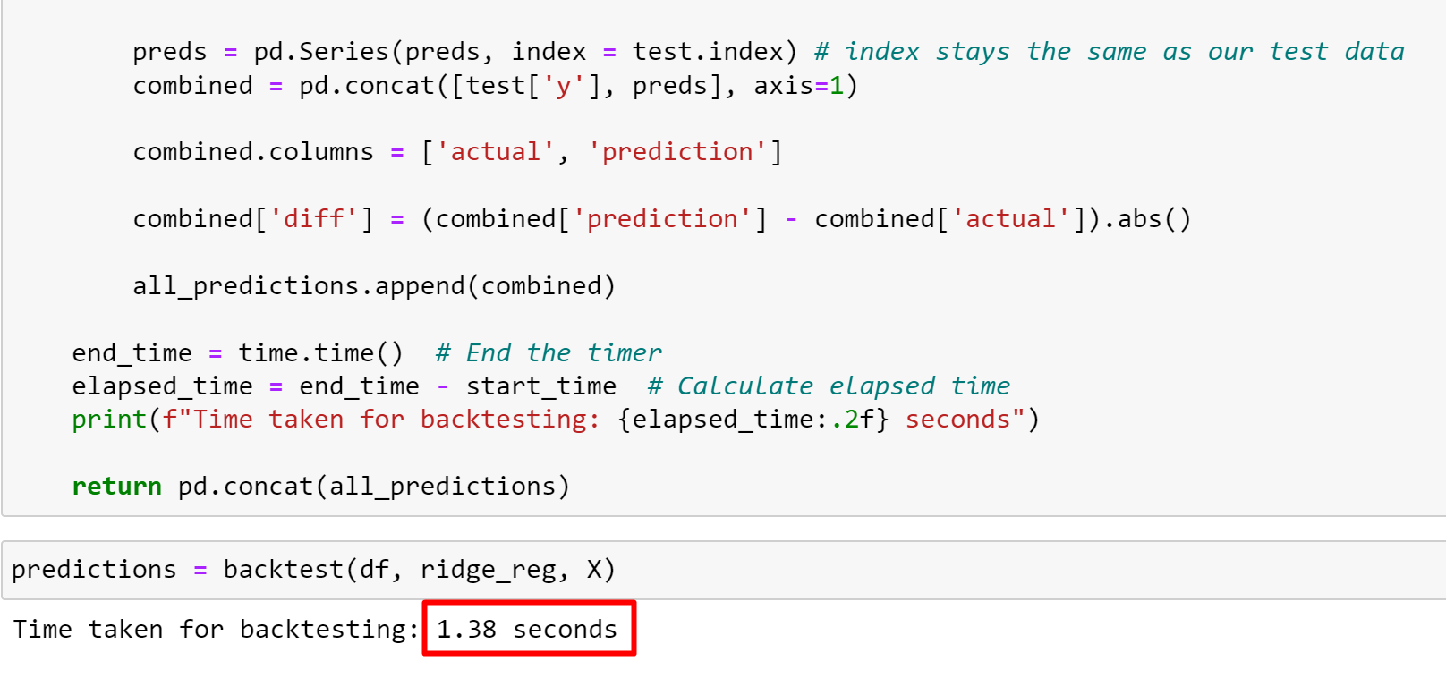
SUCCESS OF GROUP
Working Model Achieved

Slide 16
SUCCESS OF GROUP
Key Achievements and Milestones
Time Data: Collected & preprocessed weather datasets for the first time.
Model Built: Developed & trained robust time series validation model.
Model Validated: Evaluated & validated model performance using key metrics

Slide 17
Insights Gained
Technical Insights
High-quality data is crucial for building accurate models, reducing errors, and increasing reliability.
Continuous model iteration and refinement are essential for improving performance, adapting to changing weather patterns, and ensuring long-term accuracy.
Team Insights
Effective communication strategies, such as regular updates and transparent reporting, foster collaboration, trust, and informed decision-making.
Robust project management skills, including task prioritization, timelines, and resource allocation, ensure efficient progress, mitigate risks, and meet project goals.

Slide 18
Project Management Experience
Phase 1: Project Management
Roles, Project Selection, Timetable
Visual timeline using Trello
Phase 2: Solution Flow
Data source and type of analysis
Flowchart of the solution process

Slide 19
Project Management Experience
Phase 3: Data Management
Data quality and cleaning
Visuals of data cleaning process
Phase 4: Data Analysis
Processing, Modelling, and Analysis
Graphs and charts of analysis results

Slide 20
Project Management Experience
Phase 5: Documentation
Reports, Presentation, Debugging
Example pages from the documentation

Slide 21
Performance of Group
Group Dynamics
Individual Contributions
Visuals of collaborative work

Slide 22
ISSUES FACEd
Data Issues
Handling missing values and outliers
Synthetic data creation
Report Compilation
Challenges in summarizing research
Visuals of the final report
Individual Strengths and Contributions
How each member’s skills complemented the group
Creative representation

Slide 23
PROJECT SUMMARY
Successfully applied machine learning to weather forecasting using historical data and optimized models
Overcame challenges in data collection, team communication, and collaboration
Achieved high accuracy in predictions and gained valuable insights
Enhanced understanding of machine learning, data analysis, teamwork, and problem-solving skills
Opportunities for future refinement and exploration of additional applications

Slide 24
Q & A
We are excited to answer all your questions.

Slide 25
THANK YOU

